Slide 1
Assessment Solution
Submitted by: Subhra Shriti mishra

Slide 2
Contents
Solution Design
Solution Screenshots
Reports

Slide 3
Solution Design
As instructed the solution for the assessment is built in 3 phases:
Phase 1:
In this the input data is stored in Google Cloud Storage and then a python script extracts the JSON data and then pushes its contents to Cloud Pub/Sub as a message
The entire phase solution has been deployed on a docker environment for automated management for CI/CD
Phase 2:
In this phase Google Dataflow pipeline calls a python notebook which extracts the data from Cloud Pub/Sub message, separates the locations and transactions data into 2 different schemas and stores them in Google BigQuery tables
The notebook also carries out de-duplication operation on the locations data
Phase 3:
The entire processes of phases 1 and 2 are orchestrated and monitored using Google Cloud Composer and Airflow
Reports on the data from Google BigQuery are visualised using Jupyter notebooks

Slide 4
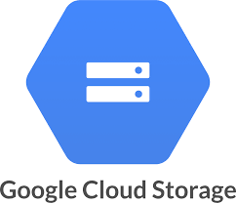
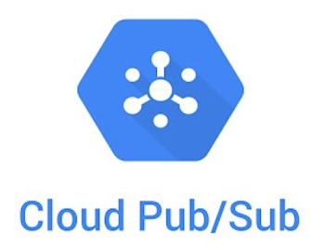


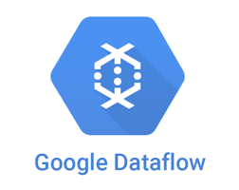






Solution Design Diagram
Phase1
Solution deployed on Docker
Phase2
Pipeline
Phase3
For managing the workflow orchestration of the phase 1 and phase 2 processes
For orchestration and monitoring of pipelines with phase 1 and phase 2 processes
Visualization of Data from BigQuery in Notebooks

Slide 5
Solution Screenshots

Slide 6
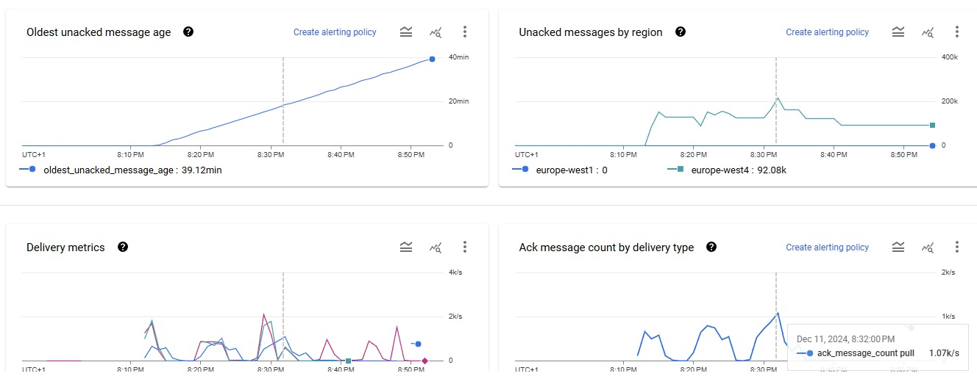
Cloud Pub/Sub Message Charts -1/2

Slide 7
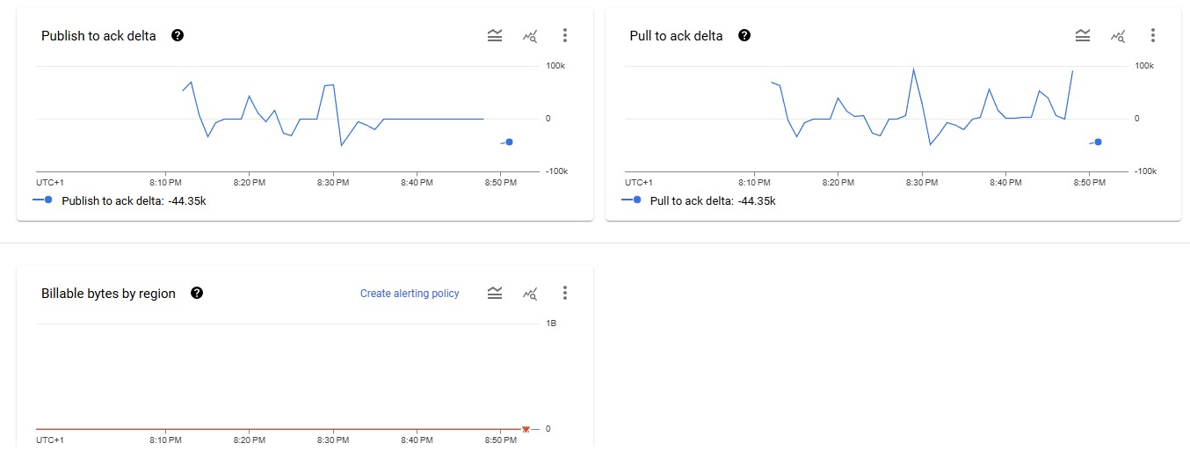
Cloud Pub/Sub Message Charts -2/2

Slide 8
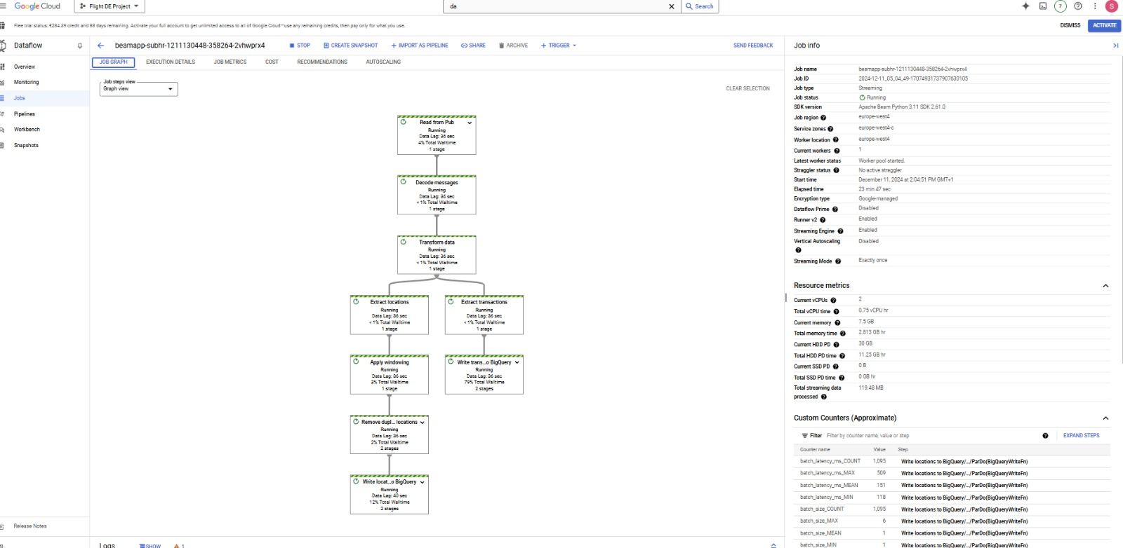
Google Dataflow Pipeline

Slide 9
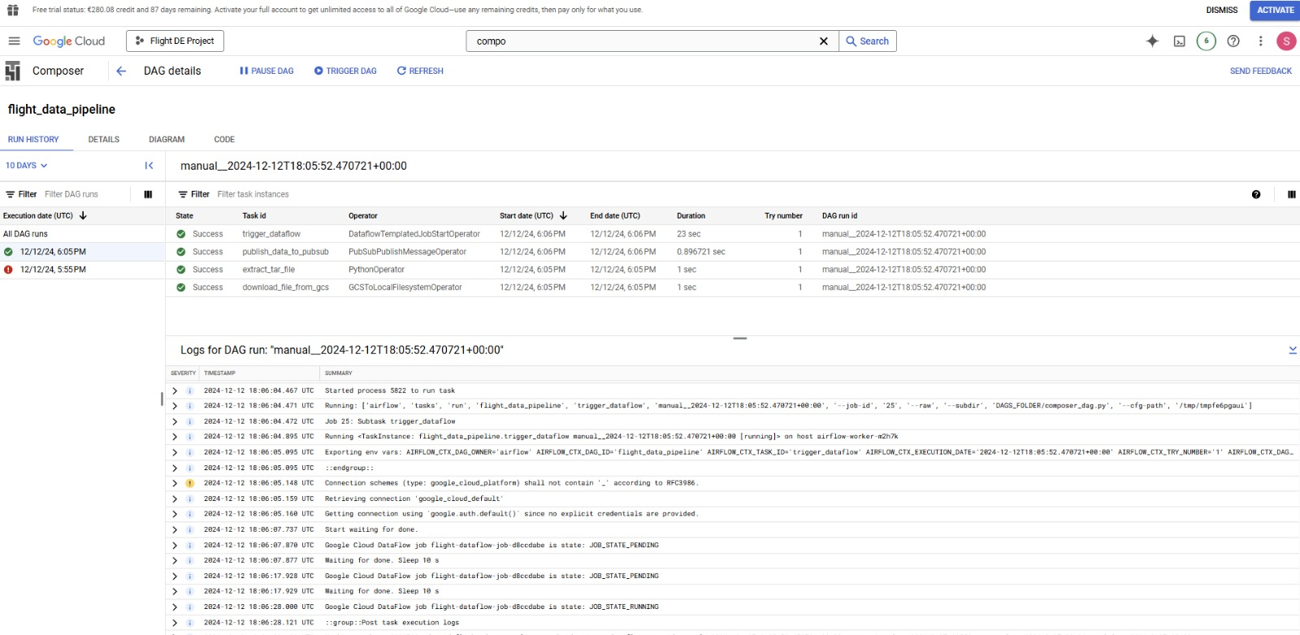
Google Cloud Composer Orchestration

Slide 10
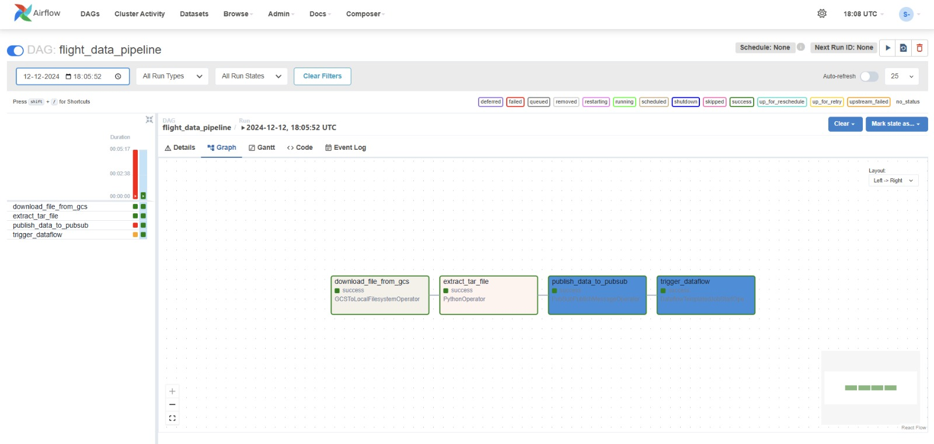
Airflow Monitoring

Slide 11
Reports

Slide 12
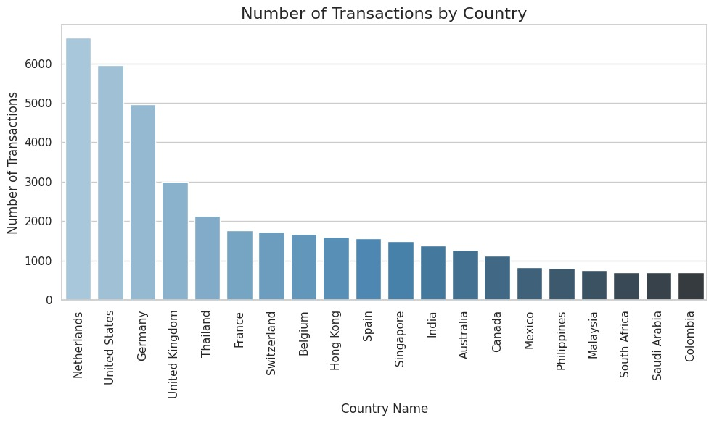

Slide 13
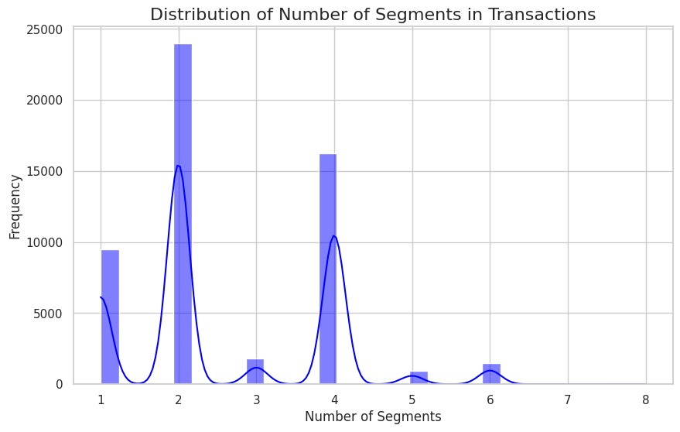

Slide 14
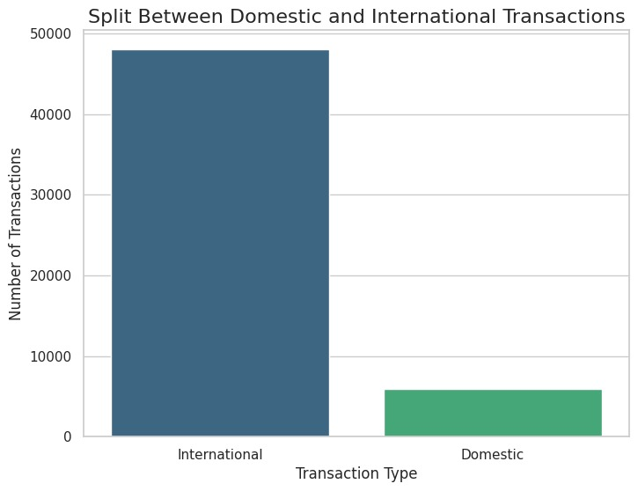
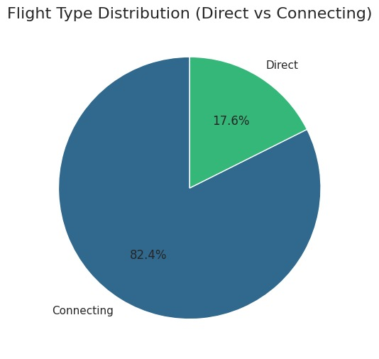

Slide 15
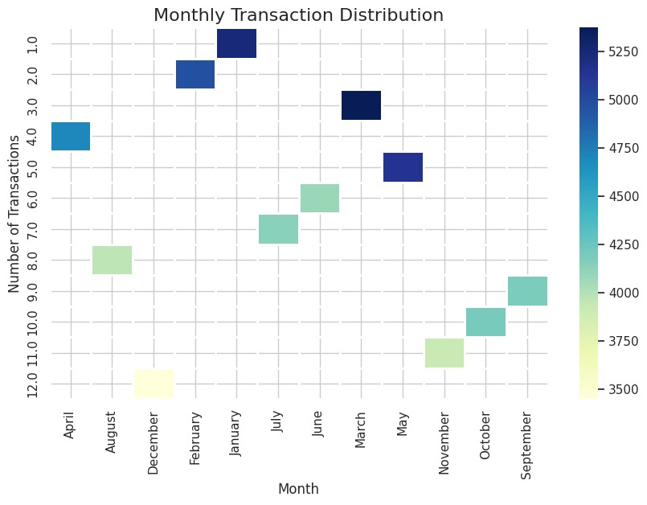

Slide 16
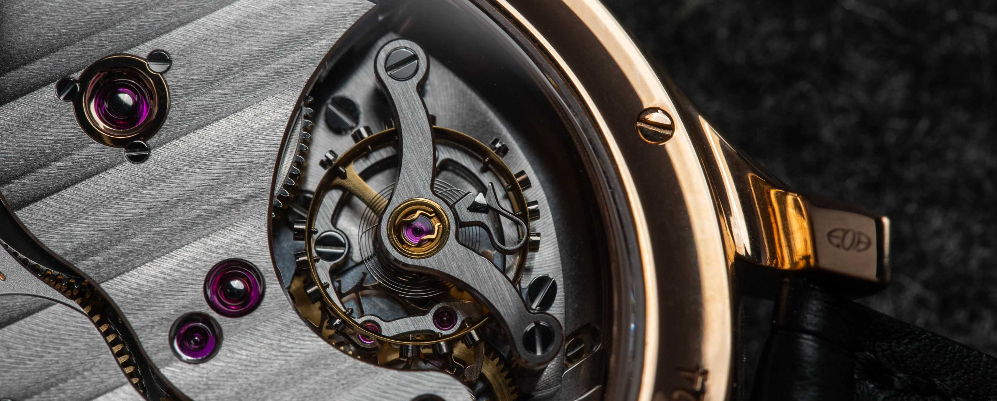
Thank You

